Slide 1
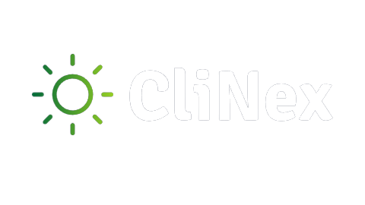


THE PLANET'S ULTIMATE CLIMATE CHANGE SOLUTION

Slide 2

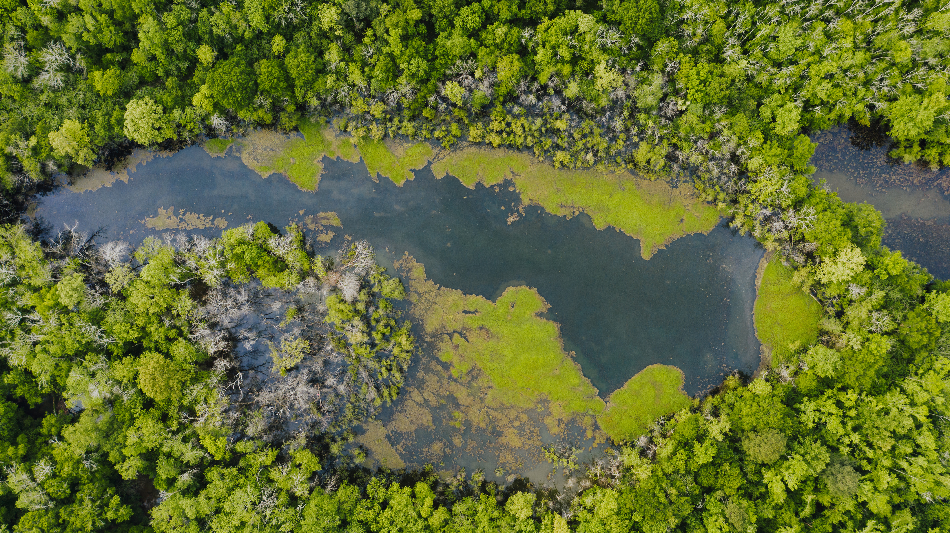
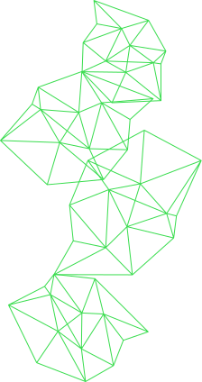
ABOUT THE STARKNET CLINEX PROJECT
Providing the most impactful solutions to climate related problems around the world. CliNex DAO is open to NGOs, businesses, agencies, and organisations. To become a member, you will have to mint CliNex tokens which give you access to the DAO. Visit the CliNex website to start interacting.
Read More >>

Slide 3

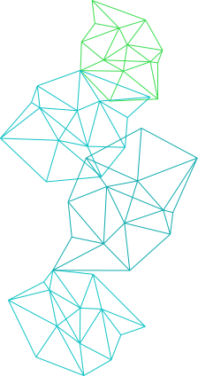
PURPOSE OF CLINEX
Our mission is to provide NGOs, businesses, agencies, and organisations with a straightforward means of supporting thousands of victims of climate change worldwide. We collect live climate change data, and using our DAO as a powerful tool, members can create, view and vote for proposals. A proposal agreed upon (voted) by the DAO is being effected i.e., if the proposal with the highest votes is to give food and shelter to the climate change victims, the DAO takes action and puts it into effect. As a means of follow-up, our website features a blog to show community updates and an admin dashboard to manage these updates.

Slide 4

CONTRACT ADDRESSES
0x01cb296d5ae3f94e244b4332b99033fb22987d9e46252414f905fece3032b23f
TOKEN CONTRACT ADDRESS
DAO CONTRACT ADDRESS
0x02036e19074e2f0087bf7bcd46b091338224d751266743c231cc44d19af327bf
CLIMATE CONTRACT ADDRESS
0x05e5aac54bfb81faf747f7064197736626fd0a7f412c77755d9da7f40ca1c015

Slide 5
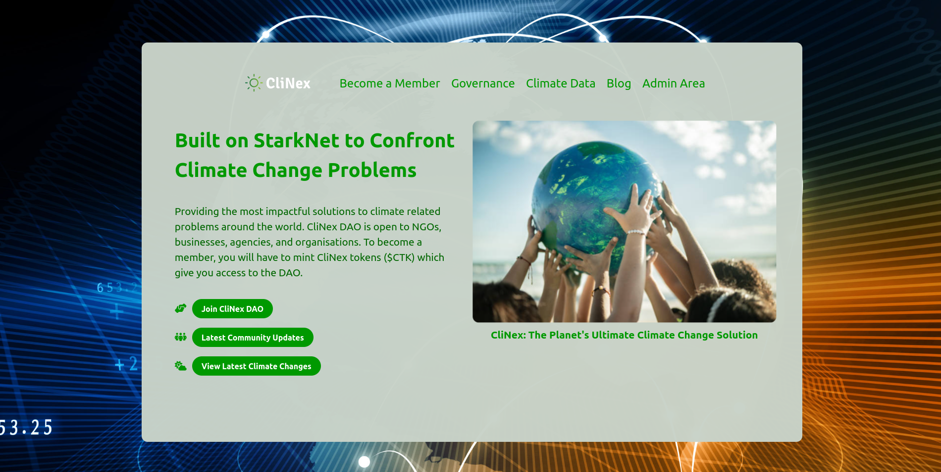
KEY FEATURES
KEY FEATURES OF CLINEX
DAO, dApp, Token, Climate data
and contract, Blog, Admin dashboard.

Slide 6

TECHNOLOGIES USED
SMART CONTRACT TOOLS
Scarb, Rust, Snforge and Cairo
FRONT END TOOLS
Technologies used for front end and integration: Starknet.js, Next.js, Tailwind CSS, JavaScript, OpenWeatherMap API, Google map API. And for the Admin page, PostgreSQL and Nodejs

Slide 7
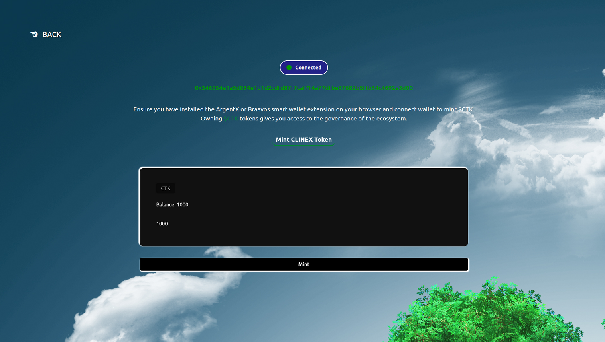
CLINEX TOKEN ($CTK)
CliNex Token is a StarkNet smart contract that implements a simple token standard. It allows users to mint and perform other token-related operations. It gives access to the DAO and allows you to become a member of the Dao and participate in the governance. To interact with this contract, ensure you have ArgentX or Braavos Smart Wallet extension installed on your browser, connect to the testnet and request for goerli Eth which will be used to pay for transaction fees.

Slide 8
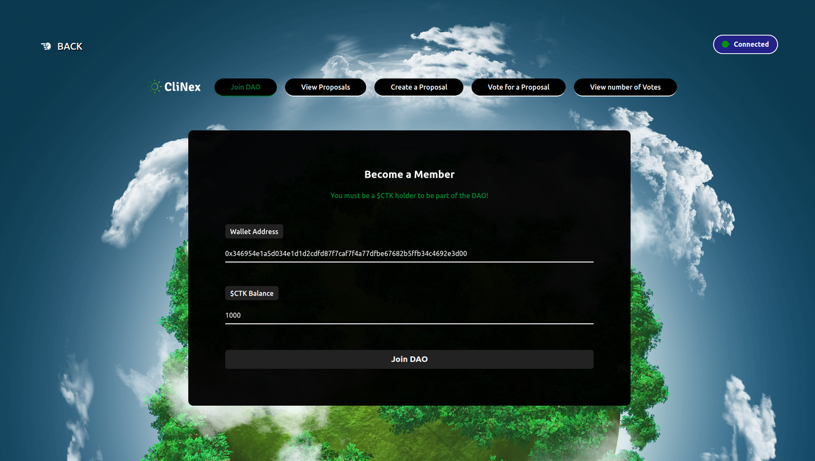
CLINEX DAO SMART CONTRACT)
CliNex Dao, a StarkNet-based DAO, combats climate change with blockchain transparency. It empowers global participants, NGOs, businesses, and agencies to contribute to sustainable practices. Token holders (minimum 1000 $CTK) engage in democratic governance, proposing and voting on solutions, influencing climate decisions, and resource allocations. To interact, use the ArgentX or Braavos Smart Wallet extension on the testnet, acquiring goerli Eth for transaction fees.

Slide 9
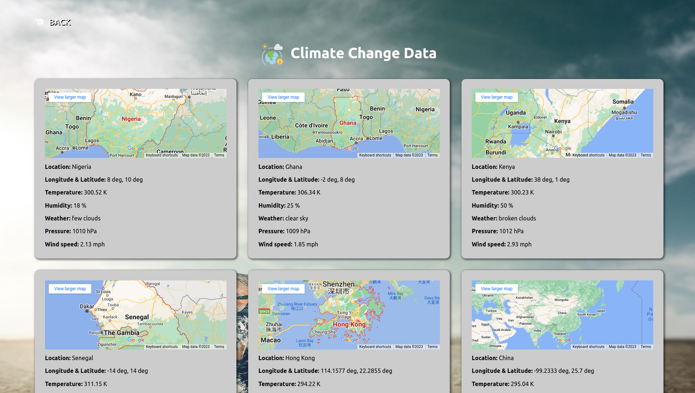
CLINEX CLIMATE CHANGE DATA API & CONTRACT
The CliNex climate change data is gotten directly from the live OpenWeatherMap API. Due to the absence of web3 Oracles providing live climate change data, the CliNex Dao and CliNex climate contract is dependent on this OpenWeatherMap API. A Google map API has also been integrated to display the maps of geographical locations we are getting data from.

Slide 10
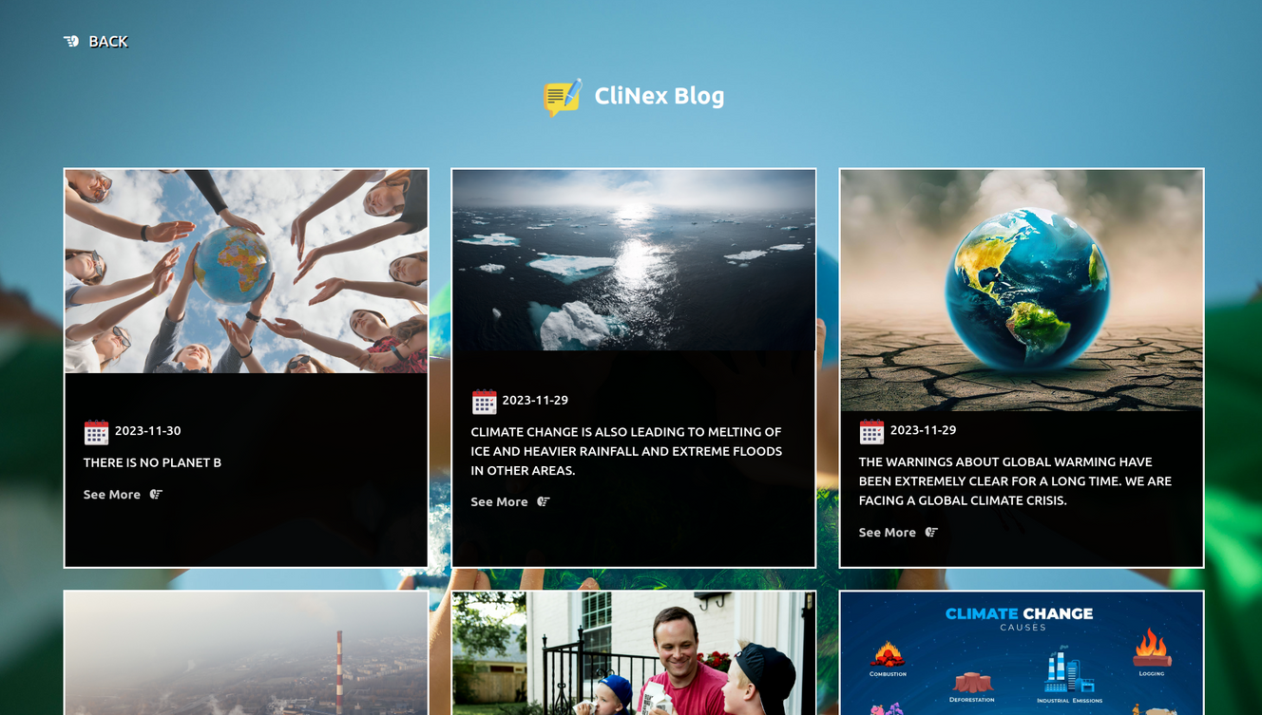
THE CLINEX BLOG
The CliNex blog serves to update the community on global climate change and the activities of CliNex members. The blog is maintained by an admin dashboard which the site's webmaster uses to add, update or delete blog posts..

Slide 11
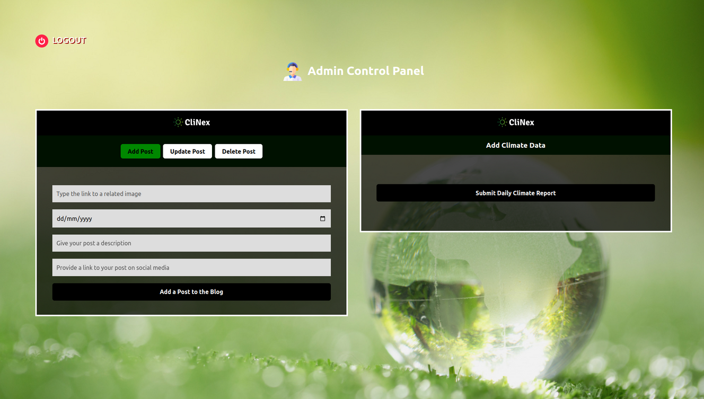
THE CLINEX ADMIN DASHBOARD
To access the admin dashboard, the site's webmaster has to login with the correct credentials, using the login page. The admin dashboard is used to add posts to the blog, update the blog posts and delete any post from the blog. It is also used by the site's webmaster to sign transactions where climate data is being sent to the climate contract on StarkNet.

Slide 12


THANK YOU!

